Slide 1
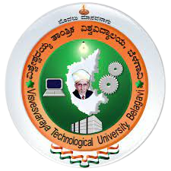
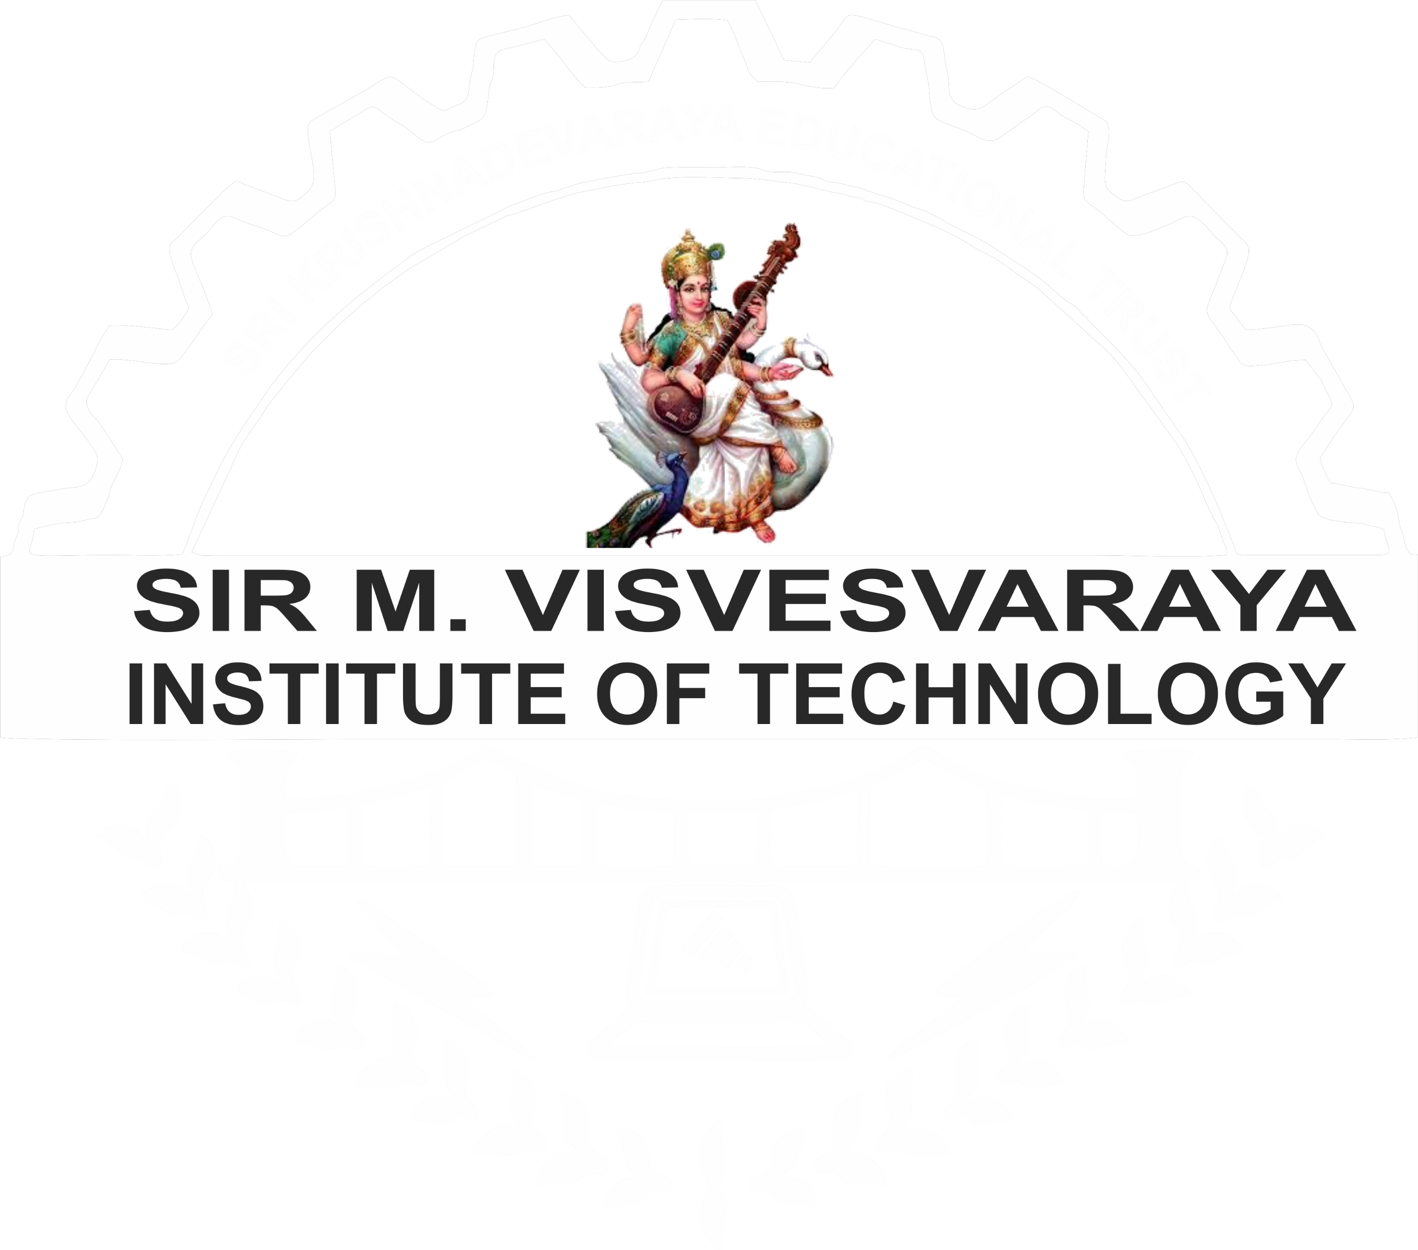
SIR M VISVESVARAYA INSTITUTE OF TECHNOLOGY Department of Mechanical Engineering Bengaluru-562157
INTERNSHIP PRESENTATION ON
OPERATING AND MAINTENANCE OF PRODUCTION EQUIPMENT IN AEROSPACE PARTS
Submitted by
KUBER
1MV20ME021
Under the Guidance of
Mr. HALESH SB
Associate Professor
Dept. of Mechanical Engineering, SMVIT

Slide 2
CONTENTS
ABOUT COMPANY
COMPANY MISSION AND VISION
INTRODUCTION
DEPARTMENT & WORK PERFORMED
OVERVIEW OF INTERNSHIP
REFLECTION OF INTERNSHIP
CONCLUSION
REFERENCES

Slide 3
ABOUT THE COMPANY
Company Name: SPIRAL EHL ENGINEERING PRIVATE Ltd.
Company address: Block-I-B plot no. 35 A3, KIADB Industrial area, Hoskote, Banglore Karnataka 562114
Established on: MAY 2004
They operate in a broad spectrum of high-tech CNC machined components and sub-assemblies, serving mission-critical industries. Spiral EHL, an AS9100D certified company, stands out due to its integrated multi-disciplinary facilities comprising a CNC machine shop, assembly floor, and testing facilities, including CMM. All of these elements enhance the company's system capabilities..

Slide 4
VISION: To be the world’s leading and truly international custom built attachment manufacturer. MISSION: Partner actively with our customers and provide high quality and affordable attachments to help them increase productivity, reduce costs and minimize risks
COMPANY VISION AND MISSION
VALUES:
EXCELENCE & QUALITY
SAFETY
CUSTOMERS
COMMUNITY

Slide 5
INTRODUCTION
Production is an interdisciplinary engineering discipline that includes manufacturing technology, engineering sciences, management sciences, and optimization of complex process, systems or organizations.
It is concerned with the understanding and application of engineering procedures in manufacturing processes and production methods
Quality Assurance (QA) is the term used in both manufacturing and service industries to describe the systematic efforts taken to assure that the product(s) delivered to customer(s) meet with the contractual and other agreed upon performance, design, reliability, and maintainability expectations of that customer.
The core purpose of Quality Assurance is to prevent mistakes and defects in the development and production of both manufactured products.

Slide 6
DEPARTMENT & WORK PERFORMED PRODUCTION PROCESS
Steps of the Production Process
Production Planning
Production Routing
Production Scheduling
Production Dispatching
1. Tool Order 2. The Job Order 3. Production Ticket 4. Time Ticket 5. Inspection Order
6. Move Order
Production Control
1.Move Order 2.Make to Order (MTO) 3.Engineer to Order (ETO) 4.Assemble to Order (ATO)
5.Production Control Software

Slide 7
DEPARTMENT & WORK PERFORMED PRODUCTION PROCESS
STEPS OF THE QUALITY ASSURANCE
Analyze the Requirements
Plan the Tests
Design the Tests
Execute Tests and Report Defects
Run Re-Tests and Regression Tests
Run Release Tests

Slide 8
OVERVIEW OF THE INTERNSHIP
Quality Control: - The quality control internship involved us in working in the quality control department of the company's production facility. - As a trainee employee, I gained hands-on experience analyzing production lines and devising test procedures. - our main goal is to identify manufacturing deficiencies that cause quality control issues.
Production : - As production interns I was involved in various tasks related to the production process. - Responsibilities may include organizing files, analyzing performance metrics, and generating reports. - Additionally, as production interns I managed equipment in the tool room and the inventory by which means the dispatch and income are been taken.
Overall Industrial Internship : - This type of internship aims to familiarize students with the industrial production process. It also focuses on quality management in an operational environment. During this internship period, I was able to develop critical thinking skills related to production processes and quality issues.

Slide 9
REFLECTION OF INTERNSHIP
Skill Development: Interns often gain hands-on experience in production processes and quality control measures, enhancing their practical skills and understanding of the industry¹.
Process Improvement: Interns may bring fresh perspectives to existing processes, potentially leading to improvements in production efficiency and product quality².
Professional Growth: Exposure to real-world challenges and solutions in production and quality control can contribute to an intern’s professional growth and readiness for future employment¹.
Organizational Benefits: Companies can benefit from the contributions of interns, whether it’s through increased productivity, the potential for future recruitment, or the influx of new ideas and competencies².
Quality Control Experience: Interns in quality control learn to analyze production lines and develop test procedures to identify manufacturing deficiencies, which is crucial for ensuring product quality¹.
Networking: Internships provide opportunities to develop professional networks within the industry, which can be valuable for future career opportunities³.
Academic Connection: Internships can also serve as a bridge between academic learning and industry practices, allowing interns to apply theoretical knowledge in a practical setting

Slide 10
CONCLUSION
In conclusion, production and quality management are critical components of the manufacturing process that ensure products meet or exceed customer expectations. Quality management involves a systematic approach to monitoring and improving all processes involved in production. It’s essential for maintaining consistency, enhancing customer satisfaction, reducing waste and rework, and ultimately increasing profitability.
Key principles of quality management include establishing clear quality objectives and standards, closely monitoring each step of the production process, and implementing robust quality control practices. These practices help in detecting and resolving issues early, preventing costly recalls or warranty claims, and optimizing resources effectively.
Moreover, quality management fosters trust among customers, business partners, and regulators, positioning companies as leaders in their field by demonstrating a dedication towards delivering superior products consistently. The ultimate objective of production management is to maximize productivity, minimize costs, and uphold product or service quality.
Maintaining the quality of products is paramount for any business, and production management incorporates quality control measures at every stage, from procurement to distribution. Implementing these practices ensures that customers receive products that meet or exceed their expectations, which is crucial for the success and sustainability of any manufacturing enterprise

Slide 11
THANK YOU

